Slide 1
EMPLOYEE TASK MANAGEMENT SYSTEM
Batch : Python 1
Project Coordinator : Mr Shirish Nagar

Slide 2
TEAM College : Jodhpur Institute of Engineering and Technology
Aditi Jain
Deepak Verma
Jyoti Rajpurohit
Kuldeep Rajpurohit
Nishtha Gehlot
Shaili Jain
Sohaib Khan

Slide 3
Problem Description
We need to make a system in which mentors can assign tasks to the employee and other mentors can monitor the availability of employees and on that basis, they can assign him/her new task. As well as employee can see all the assign task with priorities. The app should be able to: Store data on new Employee/Trainee and new Task Assignments Employees can see the availability of other employees, trainees, and interns but trainee will not able to see other availability. Employees can assign task with details like task name, task description, assigner, priority, expected hours for completion to other employee's or trainee's ToDo list considering the maximum limit of total eight hours for an employee before assigning any task.

Slide 4
Target Audience
This is a very common problem in companies that an employee already working on an assigned task and another mentor or boss going to assign him a new task, S/He might not know that employee’s availability and the priority of the task on which employee already working. In that scenario, there will be lots of communication going around to assign the task, due to which task going to be a delay. To resolve these issues and make employee availability transparent, we need to make a system in which mentors can assign tasks to the employee and other mentors can monitor the availability of employees and on that basis, they can assign him/her new task.

Slide 5





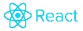
TECHNOLOGIES

Slide 6





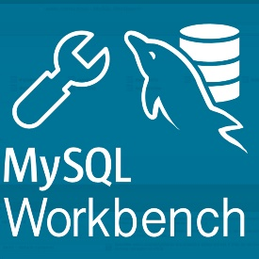
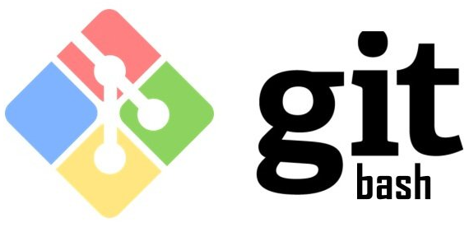
SOFTWARES

Slide 7
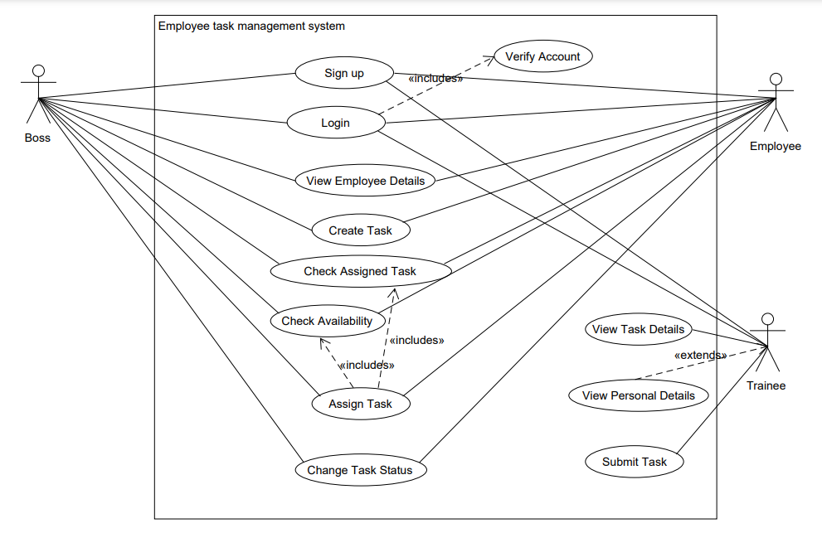
Basic Functionalities of Application

Slide 8
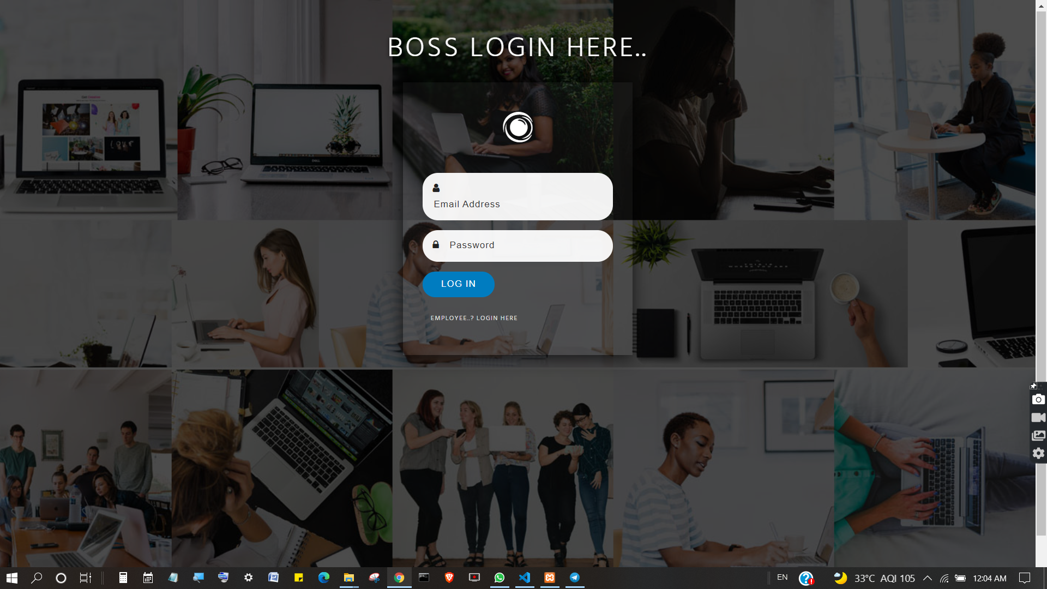
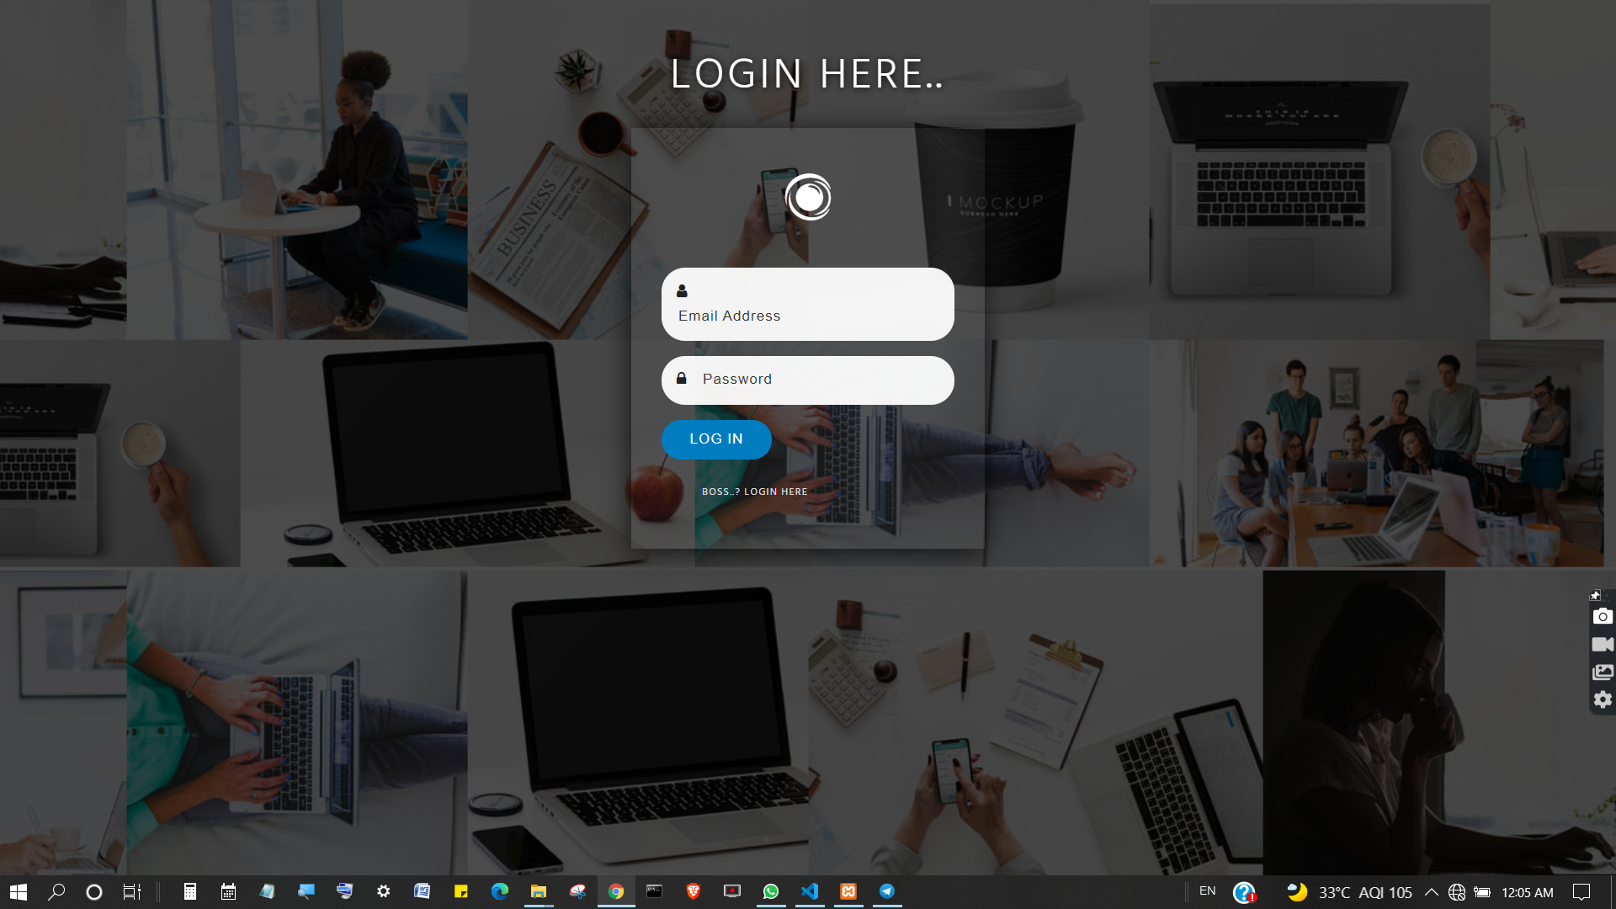
Login
Boss Login
Employee Login

Slide 9
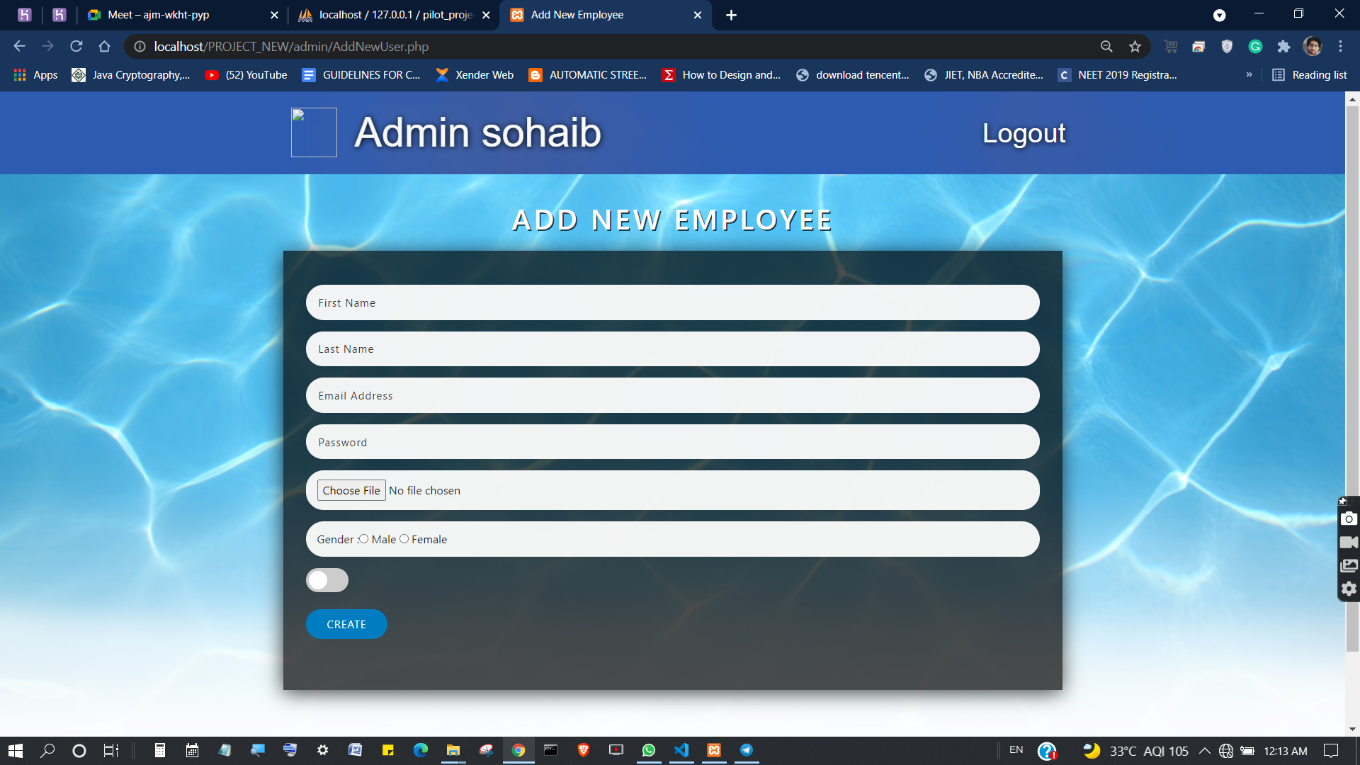
Create New Employee Account

Slide 10
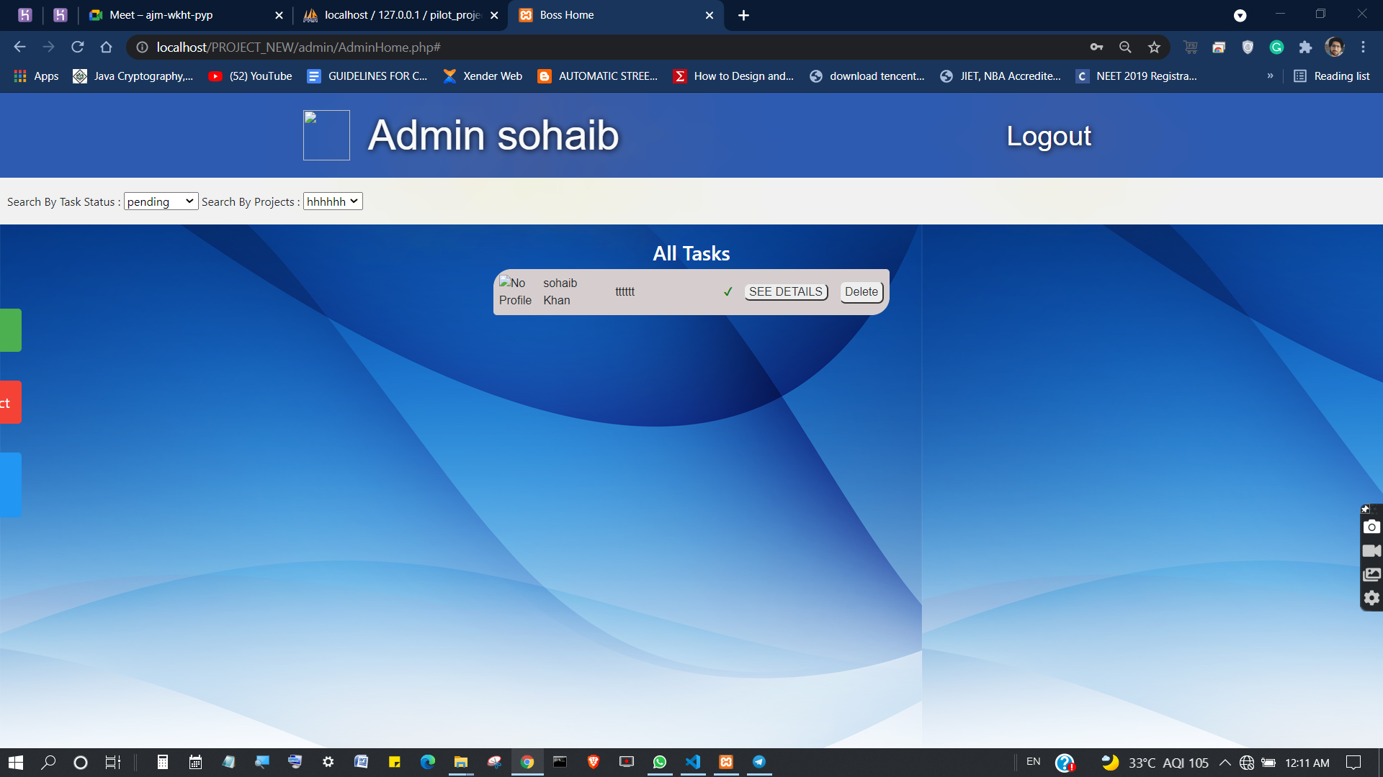
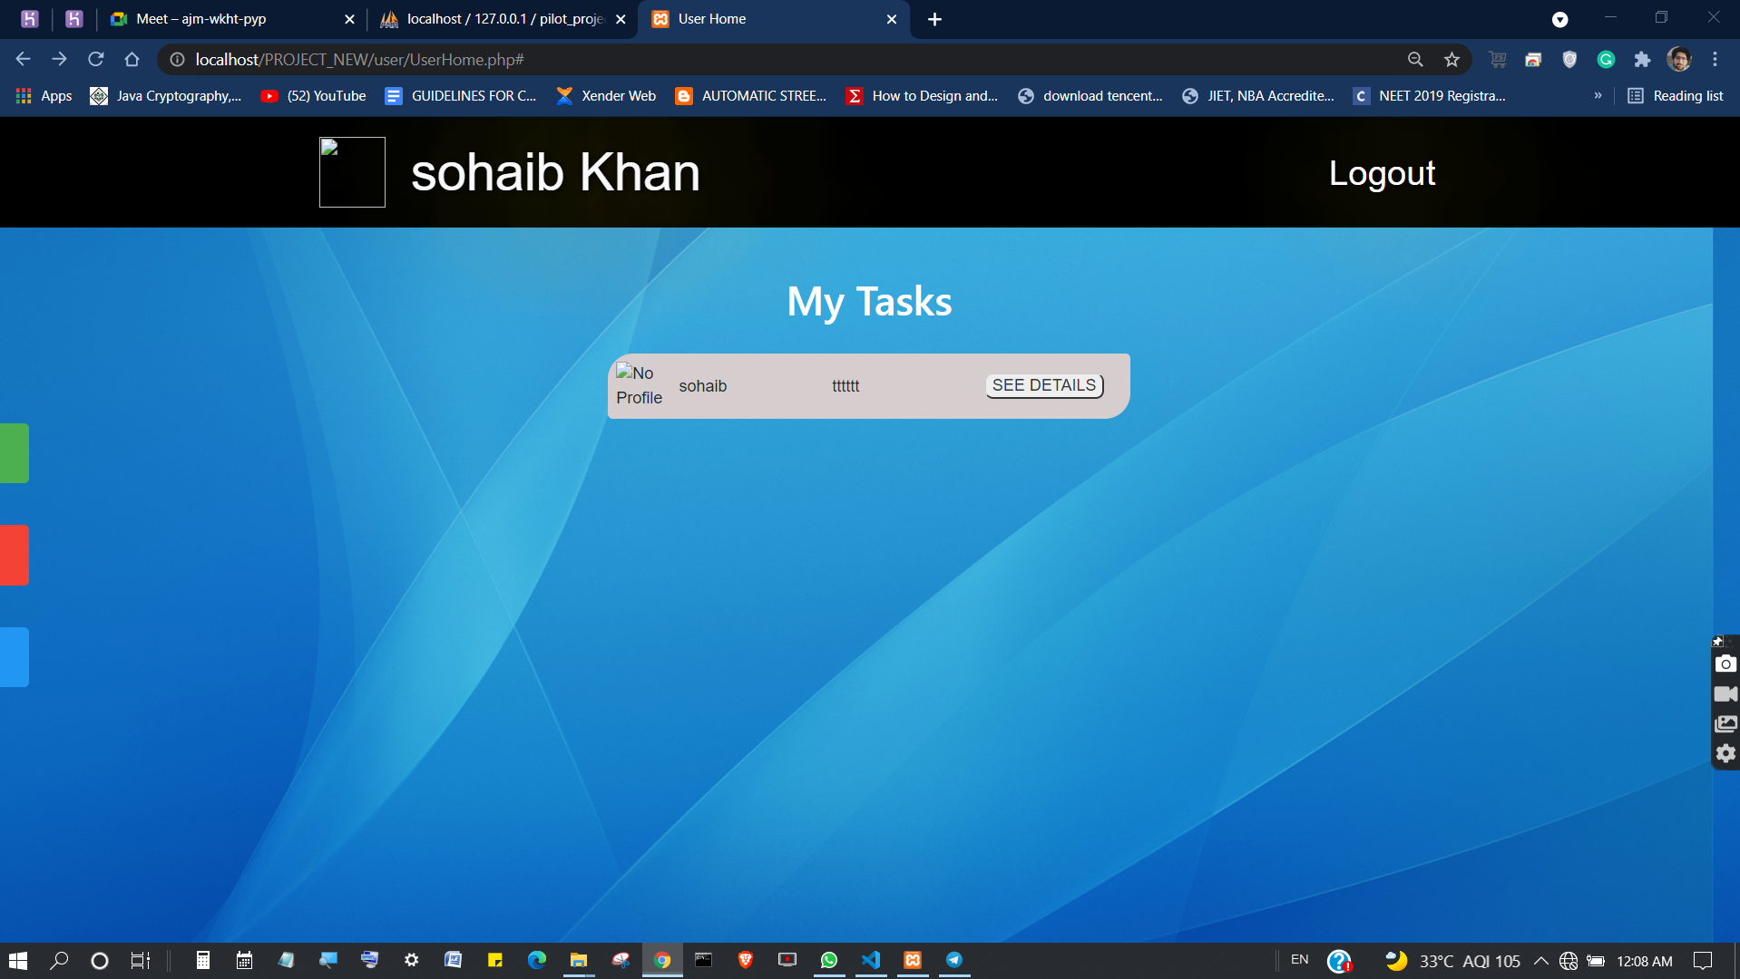
Profile / Details
Boss
Employee

Slide 11
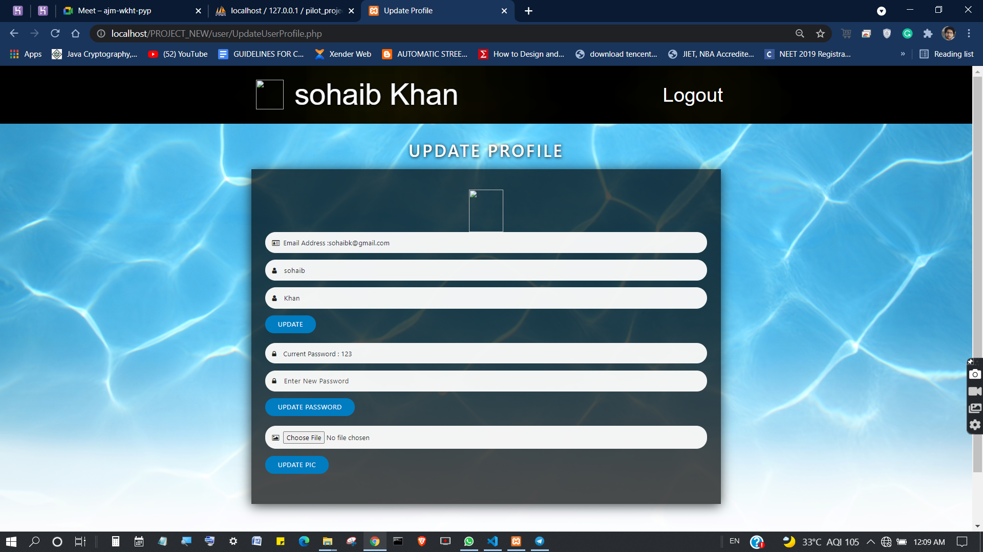
Update Profile

Slide 12
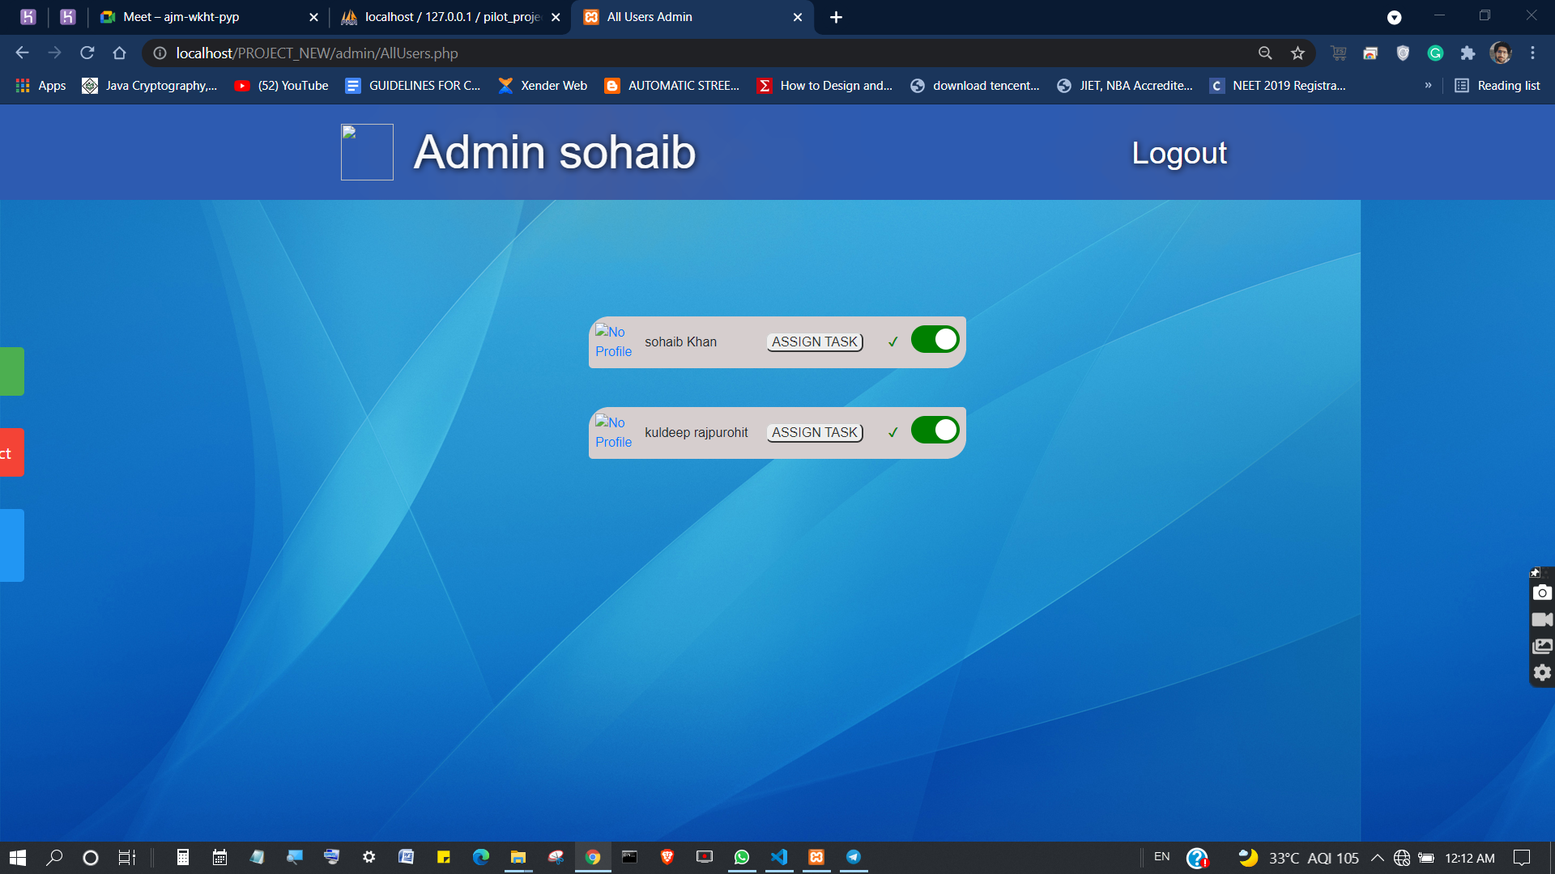
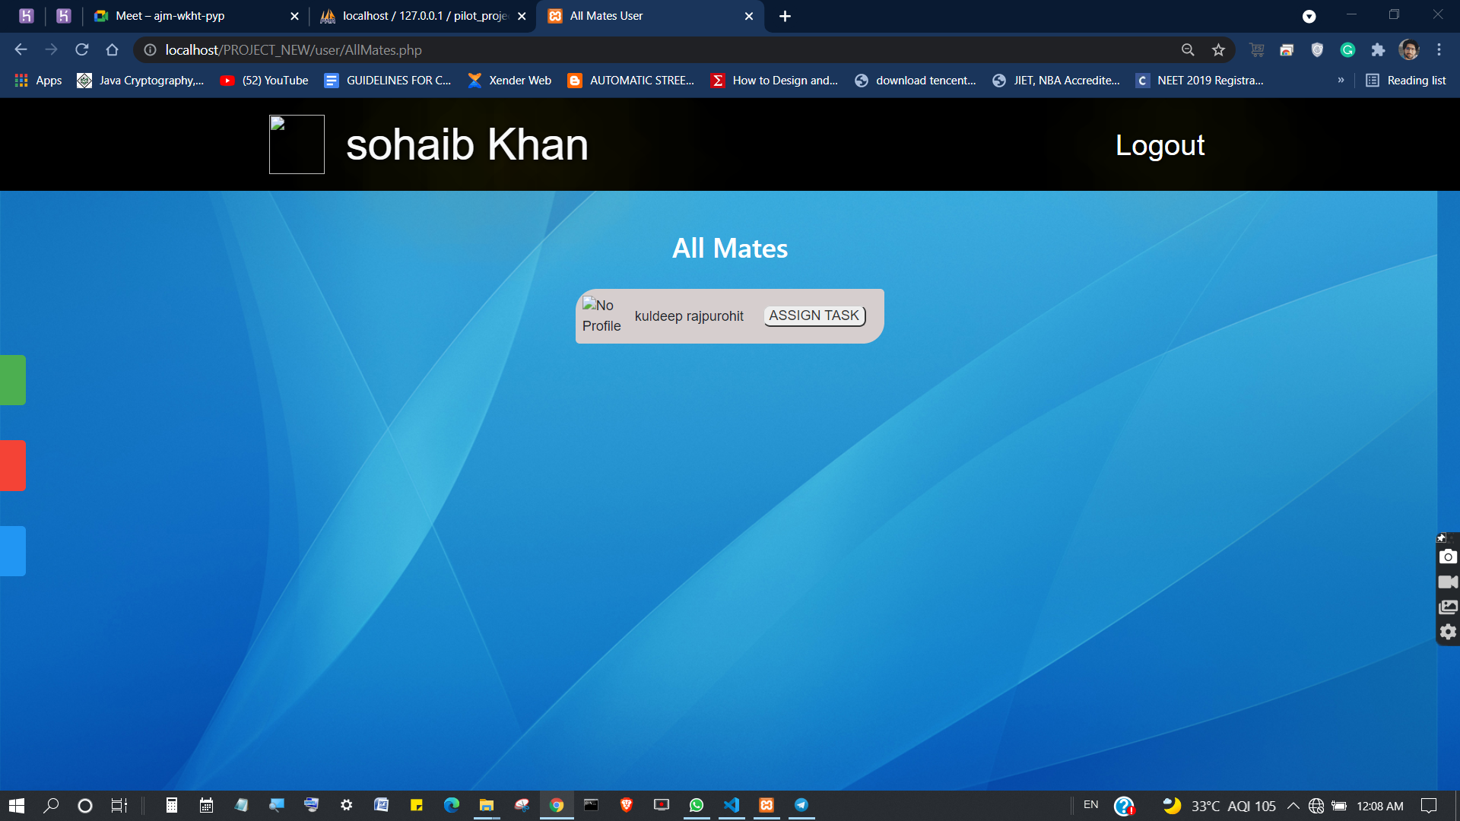
All Employees / Assign Task
List Visible to boss
List Visible to employees

Slide 13
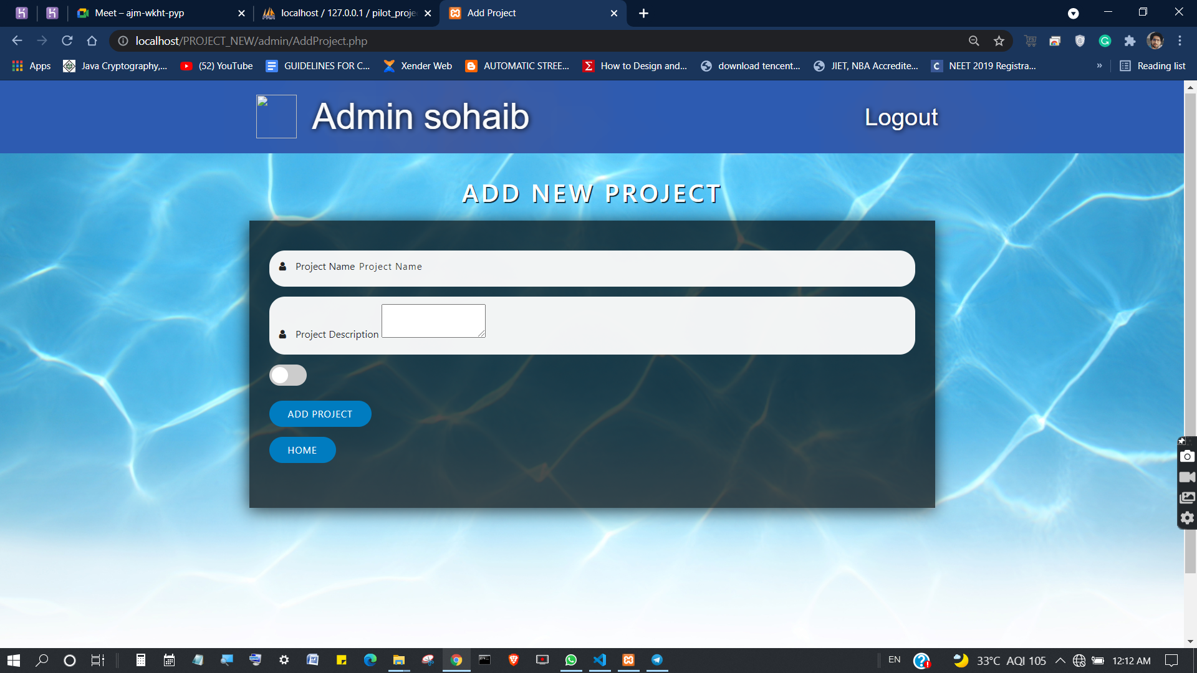
Create Task

Slide 14


Future Scope
1) AI is applied in almost every industry and may become
a standard in the near future.
2) Data visualization represents the data in a visual and understandable manner: graphs, diagrams, maps, etc.

Slide 15
Conclusion
This is a customized task management tool that enables your enterprise to manage all tasks efficiently in this troubled time & even in the post-COVID age. Our robust task management app help organizations face challenges related to project management & gain a higher Return Of Investment over the period while meeting the deadlines and utilizing resources effectively.

Slide 16
Link for the Website
http://task-management.epizy.com/
To Run the Application:
Admin Profile – sohaib@gmail.com
Password - sk123
Employee Profile – sohaibk@gmail.com
Password - 123

Slide 17

GitHub Repository Link
github.com/shaili-jain/task_management

